Slide 1
Neural Network (NN) – Forward Propagation
ANN inspired from BNN
Model representation
Activation function
Hypothesis calculation
Binary/multi - class classification
Logical operations
Handwritten digits classification

Slide 2
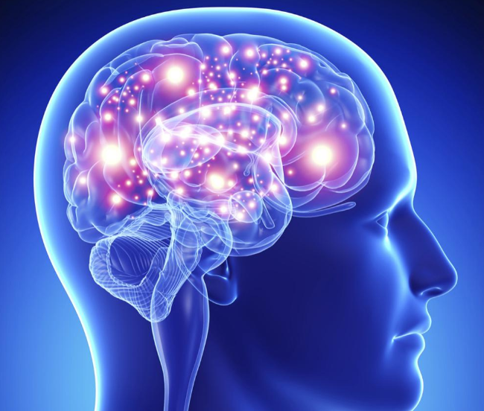
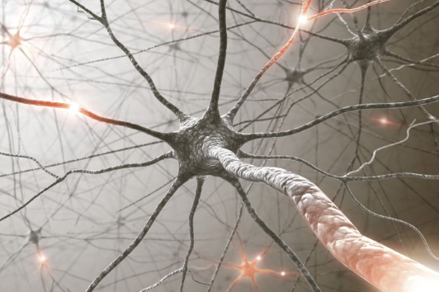
Understanding NN
neurons and the brain
NN: the state of the art technique for many different machine learning problems.
- we need to learn more complex non-linear hypotheses
How many neurons are in the brain?
state.com
The human brain: ~85 billion neurons
A cat: ~1 billion neurons
A mouse: ~75 million neurons
A cockroach: ~ a million neurons
verywellmind.com

Slide 3
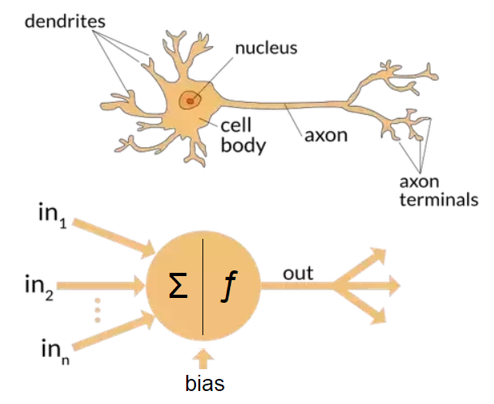
Model representation using NN
A neuron: a computational unit, that
gets a number of inputs through its input wires and does some computation in cell body and then it gives outputs via its output wire (axon) to other neurons (nodes) in the brain.
input wires
Biological NN:
output wire
Artificial Neural Networks (ANN) were developed as simulating neurons or networks of neurons in the brain.
Notes:
Dendrite:
Nucleus:
Axon:

Slide 4
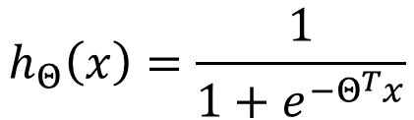


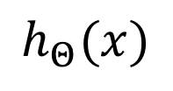
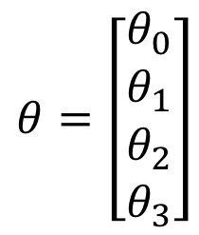



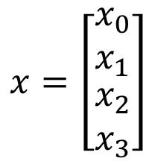
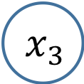


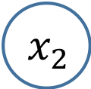


Model (ANN) representation
A single neuron
Neuron model: Logistic unit
“bias unit / neuro”
$x_{0}$=1 always
$$x_{0}$$
Sigmoid (logistic) activation function.
$$θ_{0}$$
$$h_{Θ}\left(x\right)=\frac{1}{{1+e}^{−Θ^{T}x}}$$
$$x_{1}$$
$$θ_{1}$$
Axon
(output wire)
$$x_{2}$$
$$θ_{2}$$
$Σ$|f
$$h_{Θ}(x)$$
$$x=\left[\begin{matrix}x_{0} \\ x_{1} \\ \begin{aligned}x_{2} \\ x_{3}\end{aligned}\end{matrix}\right]$$
$$θ=\left[\begin{matrix}θ_{0} \\ θ_{1} \\ \begin{aligned}θ_{2} \\ θ_{3}\end{aligned}\end{matrix}\right]$$
$$θ_{3}$$
The body of a neuron
$$x_{3}$$
Dendrites (input wires)
Input features
“weights”
parameters
Could you give the expression for $θ^{T}x$?

Slide 5
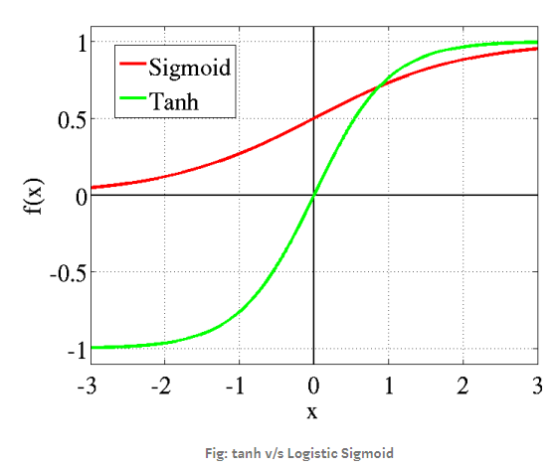
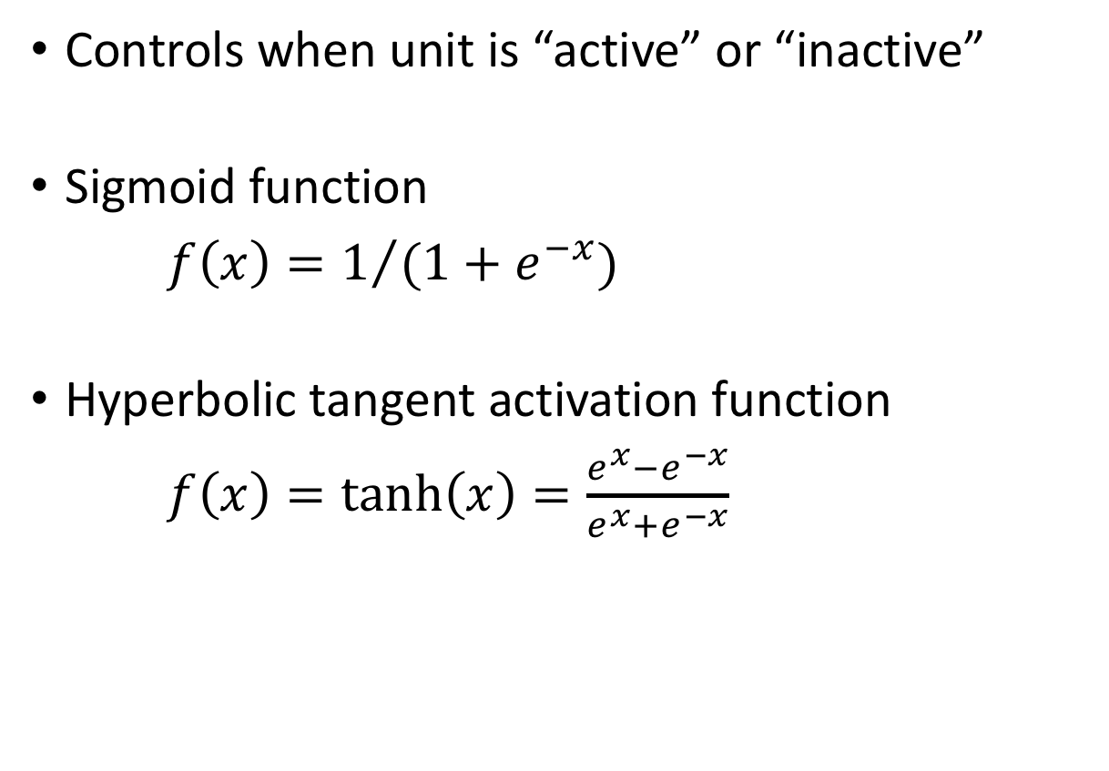
Activation functions
Controls when unit is “active” or “inactive”
Sigmoid function
$f\left(x\right)=1/{(1+e^{−x})}$
Hyperbolic tangent activation function
$f\left(x\right)=\tanh\left(x\right)=\frac{e^{x}−e^{−x}}{e^{x}+e^{−x}}$

Slide 6
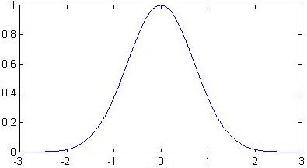
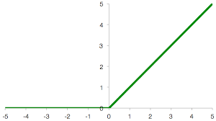
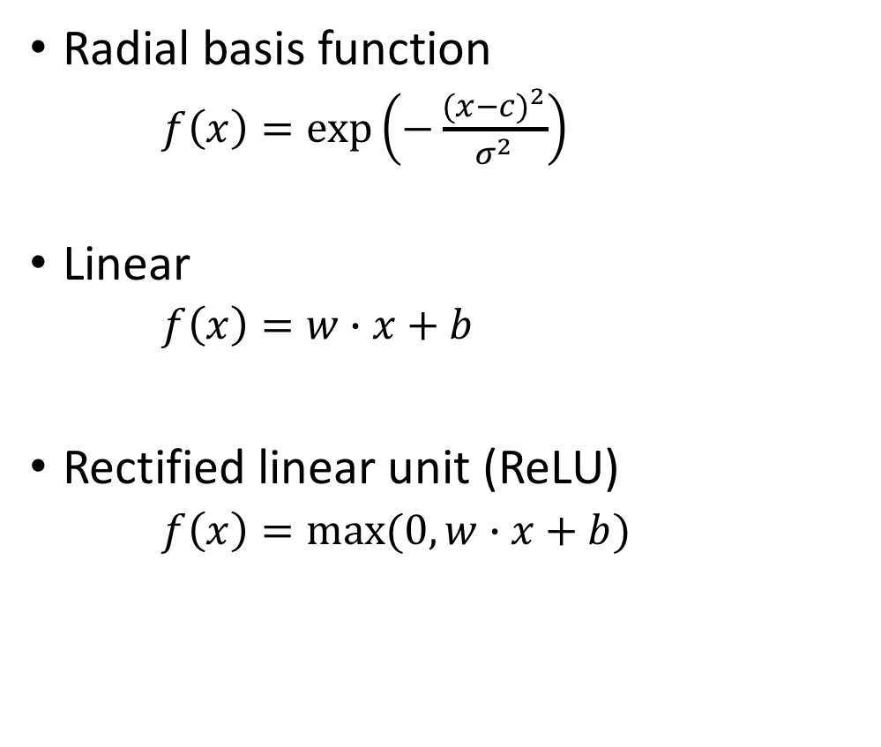
Activation functions
Radial basis function
$f\left(x\right)=\text{exp}\left(−\frac{{(x−c)}^{2}}{σ^{2}}\right)$
Linear
$f\left(x\right)=w∙x+b$
Rectified linear unit (ReLU)
$f\left(x\right)=max(0, w∙x+b)$

Slide 7





An example
“bias unit / neuro”
$x_{0}$=1 always
$$x_{0}$$
Sigmoid or Tanh or others
$$x_{1}$$
$$x_{2}$$
$$Σ|f$$
$$h_{Θ}(x)$$
$$x_{3}$$
$$:$$
$$:$$

Slide 8
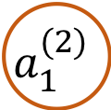
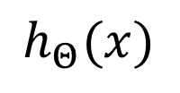
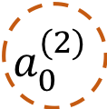
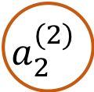

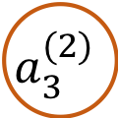
Model (ANN) representation
A group of neurons strongly linked together
“bias unit”
always1
$$x_{0}$$
$$a_{0}^{(2)}$$
$$x_{1}$$
$$a_{1}^{(2)}$$
$$x_{2}$$
$$a_{2}^{(2)}$$
$$h_{Θ}(x)$$
$$x_{3}$$
$$a_{3}^{(2)}$$
Layer 1
Layer 2
Layer 3
Input layer
Hidden layer
Output layer

Slide 9


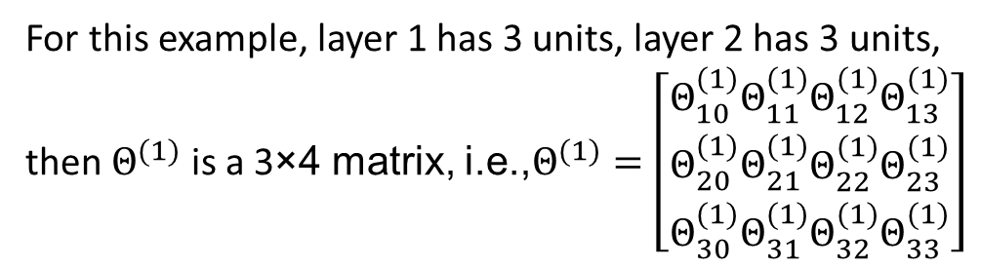



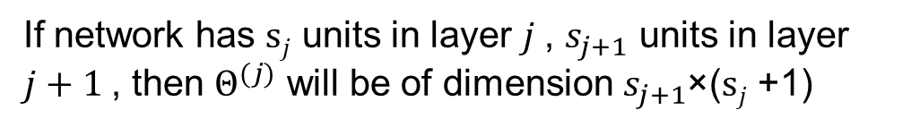
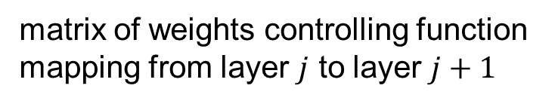



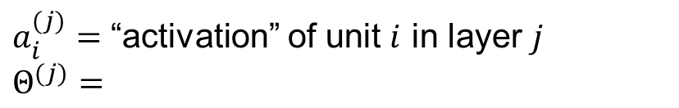





Model (ANN) representation
Parameters notation
$$x_{0}$$
$$a_{0}^{(2)}$$
$a_{i}^{(j)}=$ “activation” of unit $i$ in layer $j$
$$Θ^{(j)}=$$
matrix of weights controlling function mapping from layer $j$ to layer $j+1$
$$x_{1}$$
$$a_{1}^{(2)}$$
$$x_{2}$$
$$a_{2}^{(2)}$$
$$a_{1}^{(3)}$$
$$h_{Θ}(x)$$
If network has $sj$ units in layer $j$, $s_{j+1}$ units in layer $j+1$, then $Θ^{(j)}$ will be of dimension $s_{j+1}$×($sj$ +1)
$$x_{3}$$
$$a_{3}^{(2)}$$
$$Θ^{(1)}$$
$$Θ^{(2)}$$
For this example, layer 1 has 3 units, layer 2 has 3 units, then $Θ^{(1)}$ is a 3×4 matrix, i.e.,$Θ^{(1)}=\left[\begin{matrix}Θ_{10}^{(1)} \\ Θ_{20}^{(1)} \\ Θ_{30}^{(1)}\end{matrix}\begin{matrix}Θ_{11}^{(1)} \\ Θ_{21}^{(1)} \\ Θ_{31}^{(1)}\end{matrix}\begin{matrix}Θ_{12}^{(1)} \\ Θ_{22}^{(1)} \\ Θ_{32}^{(1)}\end{matrix}\begin{matrix}Θ_{13}^{(1)} \\ Θ_{23}^{(1)} \\ Θ_{33}^{(1)}\end{matrix}\right]$
3 input
units
3 hidden
units
1 output
unit
Question: what does $Θ^{(2)}$ look like?
Example from Andrew Ng, Machine Learning

Slide 10















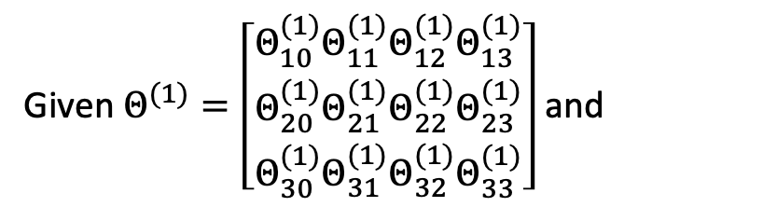



Model (ANN) representation
Forward propagation: hypothesis computation using vectorised implementation
$$x=\left[\begin{matrix}x_{0} \\ x_{1} \\ \begin{aligned}x_{2} \\ x_{3}\end{aligned}\end{matrix}\right]$$
$x_{0}$=1
$a_{0}^{(2)}$=1
Given $Θ^{(1)}=\left[\begin{matrix}Θ_{10}^{(1)} \\ Θ_{20}^{(1)} \\ Θ_{30}^{(1)}\end{matrix}\begin{matrix}Θ_{11}^{(1)} \\ Θ_{21}^{(1)} \\ Θ_{31}^{(1)}\end{matrix}\begin{matrix}Θ_{12}^{(1)} \\ Θ_{22}^{(1)} \\ Θ_{32}^{(1)}\end{matrix}\begin{matrix}Θ_{13}^{(1)} \\ Θ_{23}^{(1)} \\ Θ_{33}^{(1)}\end{matrix}\right]$ and
$$x_{1}$$
$$a_{1}^{(2)}$$
$$x_{2}$$
$$a_{2}^{(2)}$$
$$a_{1}^{(3)}$$
$$h_{Θ}(x)$$
$$a^{(2)}=g\left(Θ^{\left(1\right)}x\right)$$
Suppose Sigmoid function applied as the activation function
Calculating
$$x_{3}$$
$$a_{3}^{(2)}$$
$$Θ^{(2)}$$
$$Θ^{(1)}$$
$$a^{(1)}=x$$
$$a^{(2)}$$
$$a^{(3)}$$
and the hypothesis
$$h_{Θ}\left(x\right)=a^{(3)}=g(Θ^{(2)}a^{(2)})$$

Slide 11
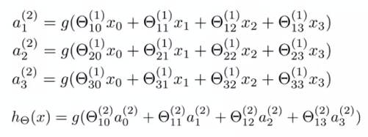








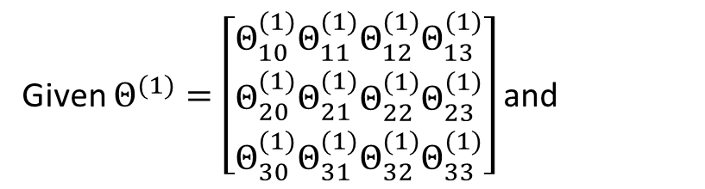










Model (ANN) representation
Forward propagation: hypothesis computation using vectorised implementation
$$x=\left[\begin{matrix}x_{0} \\ x_{1} \\ \begin{aligned}x_{2} \\ x_{3}\end{aligned}\end{matrix}\right]$$
Given $Θ^{(1)}=\left[\begin{matrix}Θ_{10}^{(1)} \\ Θ_{20}^{(1)} \\ Θ_{30}^{(1)}\end{matrix}\begin{matrix}Θ_{11}^{(1)} \\ Θ_{21}^{(1)} \\ Θ_{31}^{(1)}\end{matrix}\begin{matrix}Θ_{12}^{(1)} \\ Θ_{22}^{(1)} \\ Θ_{32}^{(1)}\end{matrix}\begin{matrix}Θ_{13}^{(1)} \\ Θ_{23}^{(1)} \\ Θ_{33}^{(1)}\end{matrix}\right]$ and
$x_{0}$=1
$a_{0}^{(2)}$=1
$$x_{1}$$
$$a_{1}^{(2)}$$
Calculating
$$a^{(2)}=g\left(Θ^{\left(1\right)}x\right)$$
$$x_{2}$$
$$a_{2}^{(2)}$$
$$a_{1}^{(3)}$$
$$h_{Θ}(x)$$
and the hypothesis
$$h_{Θ}\left(x\right)=a^{(3)}=g(Θ^{(2)}a^{(2)})$$
$$x_{3}$$
$$a_{3}^{(2)}$$
$$Θ^{(2)}$$
$$Θ^{(1)}$$
$$a^{(1)}=x$$
$$a^{(2)}$$
$$a^{(3)}$$
Example from Andrew Ng, Machine Learning

Slide 12




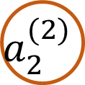
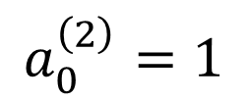


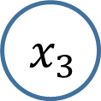


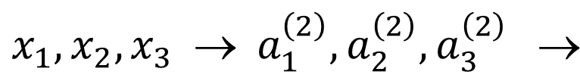
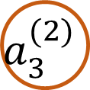

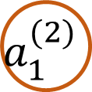
Forward propagation
NN learning its own features
$$a_{0}^{\left(2\right)}=1$$
$$x_{1}$$
$$a_{1}^{(2)}$$
$$x_{2}$$
$$a_{2}^{(2)}$$
$g(Σ )$
$$h_{Θ}(x)$$
$$x_{3}$$
$$a_{3}^{(2)}$$
$$Θ^{(1)}$$
$$Θ^{(2)}$$
Layer 1
Layer 2
Layer 3
$$Θ^{(1)}$$
$$Θ^{(2)}$$
$$x_{1},x_{2},x_{3} → a_{1}^{\left(2\right)},a_{2}^{\left(2\right)},a_{3}^{\left(2\right)} $$
$h_{Θ}\left(x\right)=g(Θ_{10}^{\left(2\right)}a_{0}^{\left(2\right)}+Θ_{11}^{\left(2\right)}a_{1}^{\left(2\right)}+Θ_{12}^{\left(2\right)}a_{2}^{\left(2\right)}+Θ_{13}^{\left(2\right)}a_{3}^{\left(2\right)})$
Example from Andrew Ng, Machine Learning

Slide 13
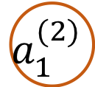



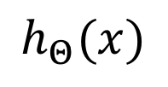
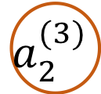


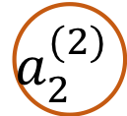
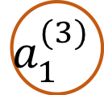






More complex network structure with multiple hidden layers
Each neuron tightly linked to/from those neurons at adjacent layers
$$x_{1}$$
$$a_{1}^{(2)}$$
$$a_{1}^{(3)}$$
$$x_{2}$$
$$a_{2}^{(2)}$$
$$h_{Θ}(x)$$
$$a_{2}^{(3)}$$
$$x_{3}$$
$$a_{3}^{(2)}$$
$$:$$
$$:$$
$$:$$
$$:$$
$$:$$
$$:$$
Layer 1
Layer 2
Layer 3
Layer 4
Input layer
2 hidden layers
Output layer

Slide 14
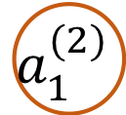
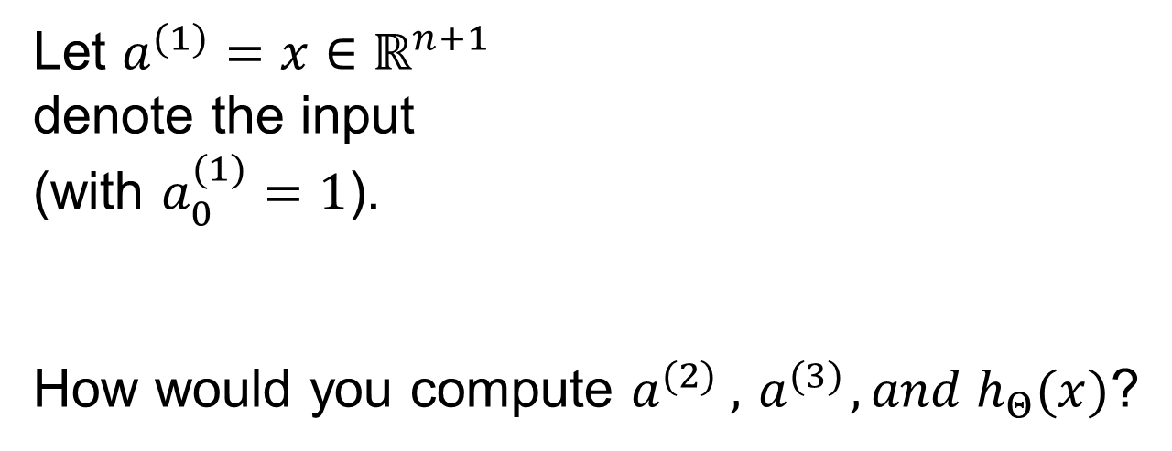

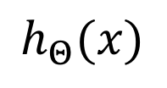








Exercise:
Consider the network:
$$x_{1}$$
$$a_{1}^{(2)}$$
$$a_{1}^{(3)}$$
$$x_{2}$$
$$a_{2}^{(2)}$$
$$h_{Θ}(x)$$
Let $a^{(1)}=x∈ℝ^{n+1}$
denote the input
(with $a_{0}^{(1)}=1$).
How would you compute $a^{(2)} ,{ a}^{(3)}, and{ h}_{Θ}(x)$?
$g(Σ )$
$$a_{2}^{(3)}$$
$$x_{3}$$
$$a_{3}^{(2)}$$
Layer 4
Layer 3
Layer 1
Layer 2
Again, given Sigmoid function is selected as activation function.
Example from Andrew Ng, Machine Learning

Slide 15












A logic operation example: AND
$y=x_{1} AND x_{2}$
$$x_{1}, x_{2}∈\left\{0, 1\right\}$$
Then
$$h_{Θ}\left(x\right)=g\left(Θ^{T}x\right)=$$
$$g(−50+30x_{1}+30x_{2})$$
$$+1$$
-50
+30
+30
$$x_{1}$$
$$h_{Θ}(x)$$
$$x_{2}$$
So we have a truth table
$$Θ^{(1)}=\left[\begin{matrix}Θ_{10}^{(1)} \\ Θ_{11}^{(1)} \\ Θ_{12}^{(1)}\end{matrix}\right]=\left[\begin{matrix}−50 \\ +30 \\ +30\end{matrix}\right]$$
$$≈x_{1} AND x_{2}$$
$$g\left(−50\right)≈0$$
$$g\left(−20\right)≈0$$
$$g\left(−20\right)≈0$$
$g\left(+10\right)≈$ 1

Slide 16
A logic operation example: OR
Think about how to design a simple NN structure for logic OR operation?

Slide 17






We have known $x_{1}$ AND $x_{2}$,
$x_{1}$ OR $x_{2}$
Negation:
$$+1$$
30
-50
$g\left(+30\right)≈$ 1
$$g\left(−20\right)≈0$$
$$h_{Θ}(x)$$
$$x_{1}$$
$$h_{Θ}\left(x\right)=g\left(Θ^{T}x\right)=g(30−50x_{1})$$

Slide 18




Exercise:
Example from Andrew Ng, Machine Learning

Slide 19

Multi-class classification using NN
http://yann.lecun.com/exdb/mnist/

Slide 20



Handwritten digits classification using NN
Multiple output units: 10
If $h_{Θ}(x)≈\left[\begin{aligned}\begin{matrix}1 \\ 0 \\ \begin{aligned}0 \\ ⁞\end{aligned}\end{matrix} \\ 0\end{aligned}\right]$ then digit 0
If $h_{Θ}\left(x\right)≈\left[\begin{aligned}\begin{matrix}0 \\ 1 \\ \begin{aligned}0 \\ ⁞\end{aligned}\end{matrix} \\ 0\end{aligned}\right]$ then digit 1,
$⁞$
If $h_{Θ}\left(x\right)≈\left[\begin{aligned}\begin{matrix}0 \\ 0 \\ \begin{aligned}0 \\ ⁞\end{aligned}\end{matrix} \\ 1\end{aligned}\right]$ then digit 9
$$h_{Θ}(x)$$
Michael Nielsen, Neural Networks and Deep Learning
http://neuralnetworksanddeeplearning.com/index.html

Slide 21

An example from Michael Nielsen’s online book:

Slide 22


An example from Michael Nielsen’s online book (Continued)
Different hidden neurons triggered to recognise digit 0
https://towardsdatascience.com/multi-layer-neural-networks-with-sigmoid-function-deep-learning-for-rookies-2-bf464f09eb7f

Slide 23

Exercise:
Suppose you have a multi-class classification problem with 3 classes (e.g., healthy control, mild cognitive impairment, and Alzheimer’s disease classification/recognition). Your neural network has 3 layers, and the hidden layer (layer 2) has 5 units. Using the one-vs-rest method described in previous slide, how many elements does $Θ^{(2)}$ have?

